Slide 1
Nail Salon Management System
Deliverable 3: Design Phase
Salman Khan, Hamza Mir, Thomas Zhang, Spencer Wilkins, Derek Luong, Asad Khan
https://github.com/tzhang490/IS-436.git

Slide 2
Project Recap

Slide 3
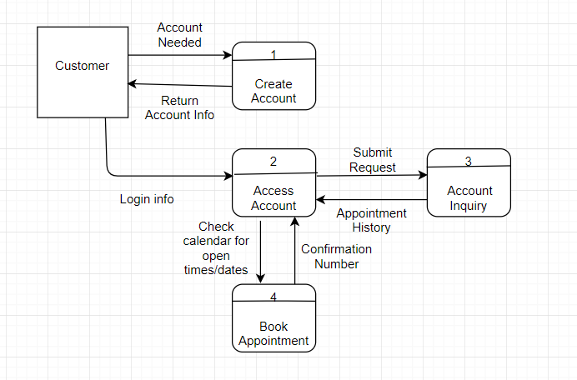
Level 0 diagram
Notes:
Describe text definitions of level 0 diagram when presenting

Slide 4
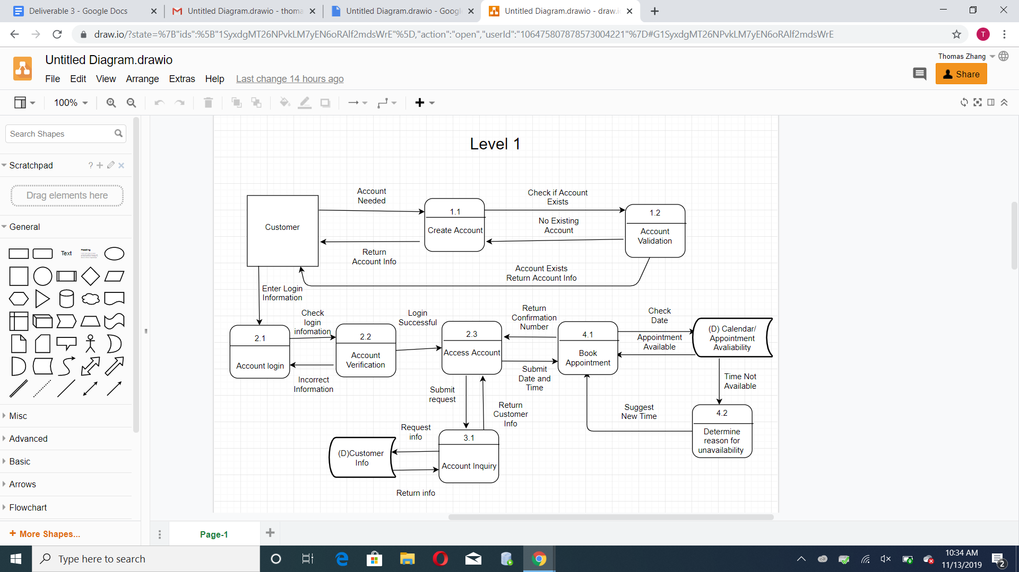
Level 1: Diagram
Notes:
Briefly describe diagram

Slide 5

Level 1- Process: Create Account

Slide 6
Level 1- Process: Accessing Account

Slide 7
Level 1- Process: Account Inquiry

Slide 8
Level 1- Process: Book Appointment

Slide 9
Updates to Requirement Documentation
Simplified project, removed reward system/ point tracking from transaction purchases and transaction tracking from process design
Emphasized account creation and appointment scheduling ability on process section.
Updated information design specifying customer ability to view appointment and account information

Slide 10
Update to Use Cases
Remove reward system use case
Fixed and updated minor errors on remaining use cases

Slide 11
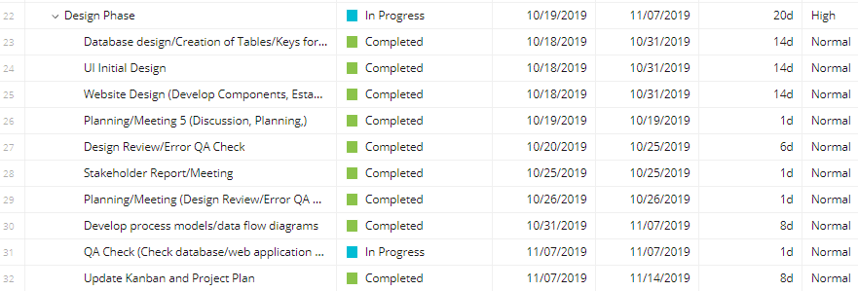
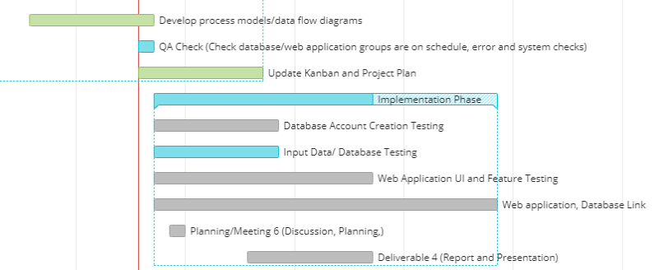
Project Plan

Slide 12
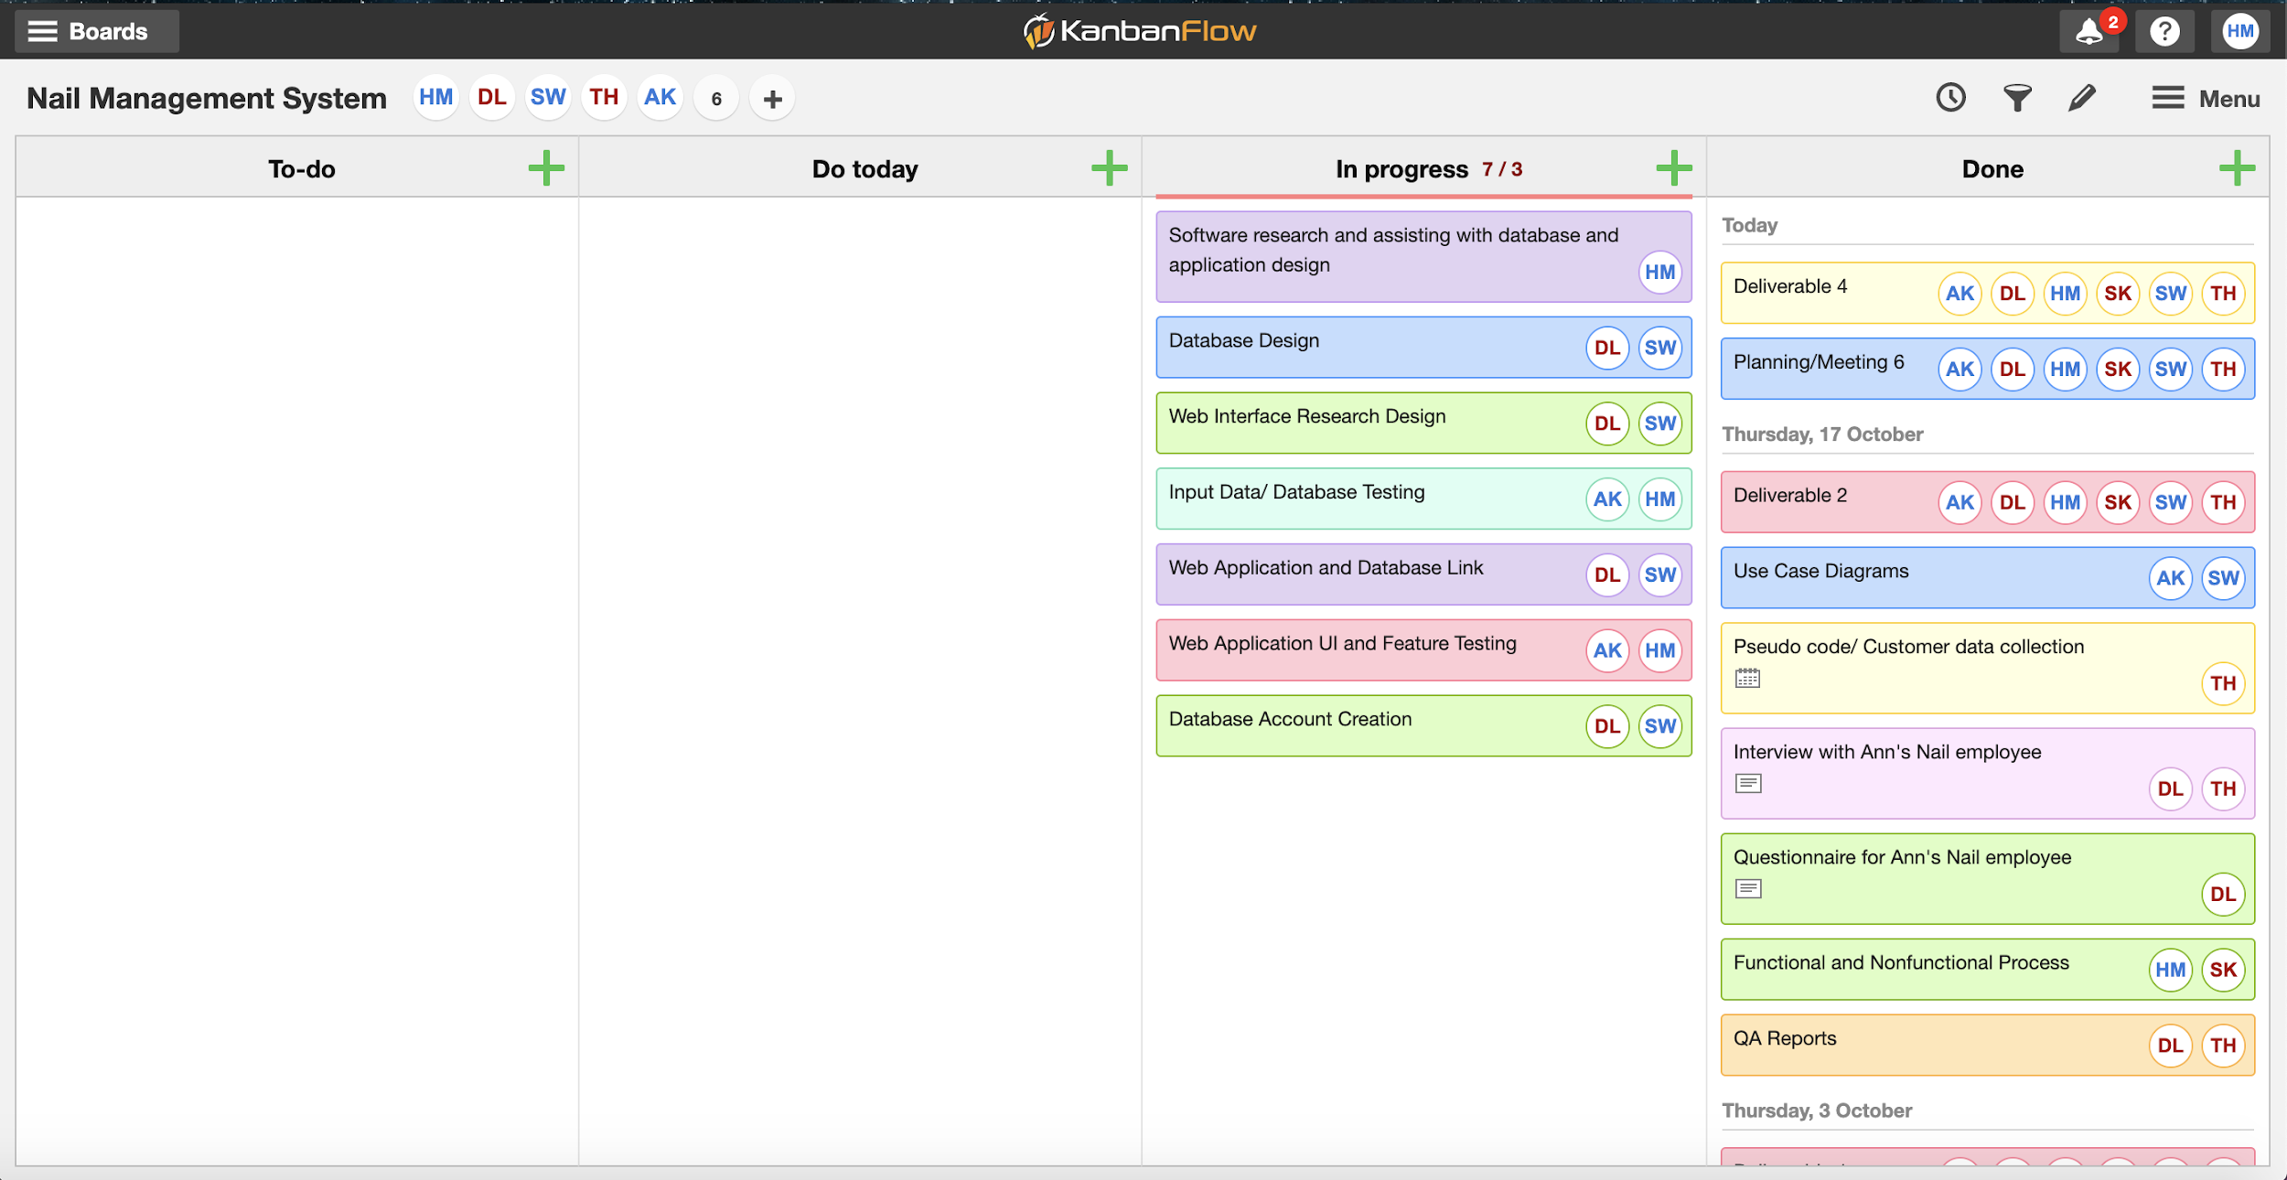
Kanban

